Slide 1
Intelligent Student Performance Analytics
Presenter: R.M Danuka Dilshan
Index Number: 268386H
Course: CS 5803 – Advanced Data Mining

Slide 2
Introduction & Objectives
Understanding Potential: Analyzing how students perform is important for identifying weak areas, learning gaps, and overall potential.
01
Core Objective: This project utilizes machine learning techniques to study past student data and predict future performance.
02
Two-Part Approach: The study applies supervised learning to predict scores and unsupervised clustering to group students based on behavior and academics.
03
Ultimate Goal: These insights aim to help improve the education system and support students more effectively.
04

Slide 3

Dataset & Preprocessing
Data Source: The dataset focuses on students from two Portuguese high schools, separated into Mathematics and Portuguese courses.
01
Features: It includes school reports and questionnaires detailing academic records, demographics, and social background attributes.
02
Data Quality: Initial checks confirmed there were no missing values or duplicate records in the data.
03
Preparation: Categorical variables were standardized and converted into numerical formats using pandas' get_dummies function for further analysis.

Slide 4
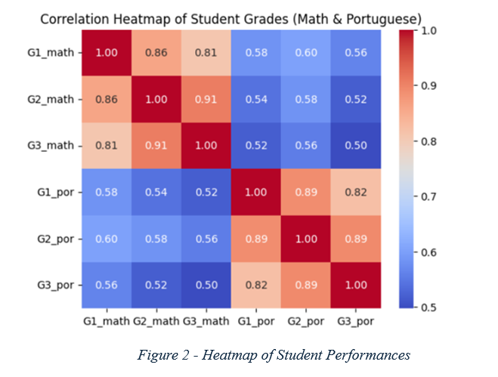
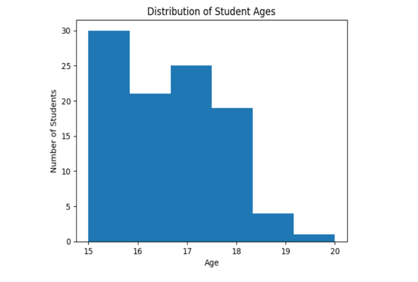
Exploratory Data Analysis
Age Demographics: The age distribution of the students is positively skewed.
Primary Age Range: The vast majority of students fall within the 15 to 18 age range.
Subject Correlation: Students who achieve high final marks (G3) in Mathematics generally tend to perform well in Portuguese.
Relationship Strength: A correlation value of approximately 0.50 indicates a moderate positive relationship between the two subjects.

Slide 5
Predicting Performance (Supervised Learning)
The dataset was split with 70% used for model training and 30% reserved for testing.

Slide 6
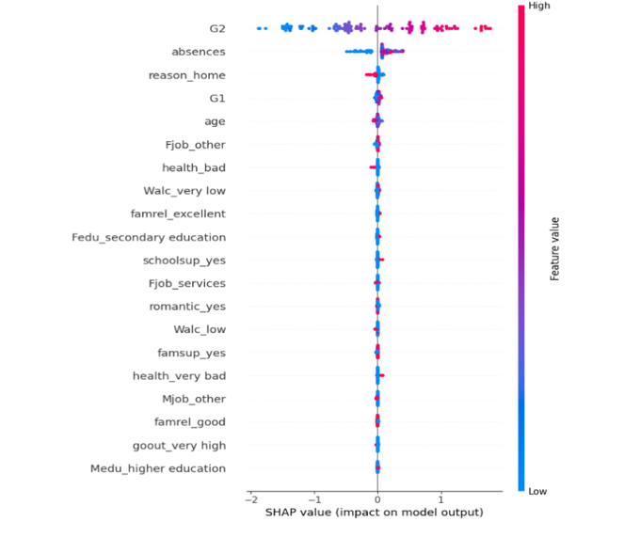
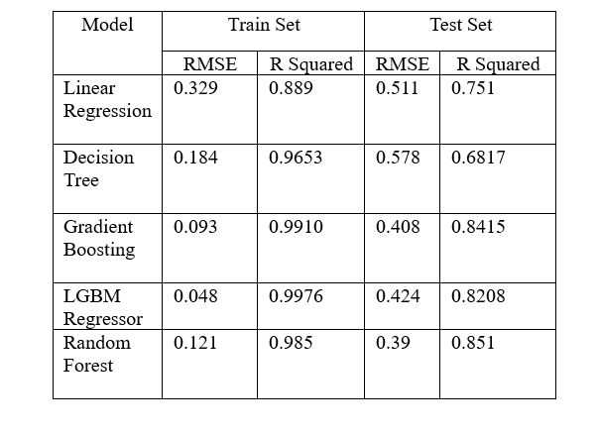
Predicting the Student Math’s Score
To forecast students' math scores, we are utilizing several models, with the resulting graphs shown below.

Slide 7
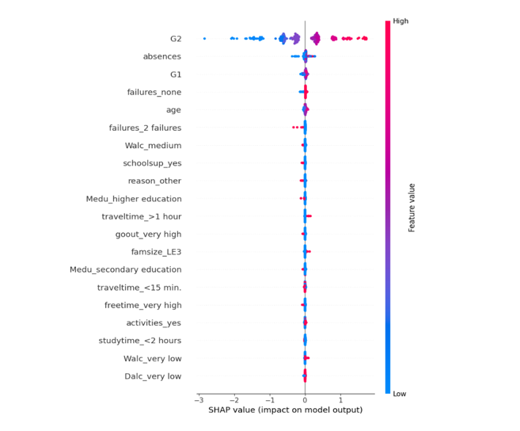
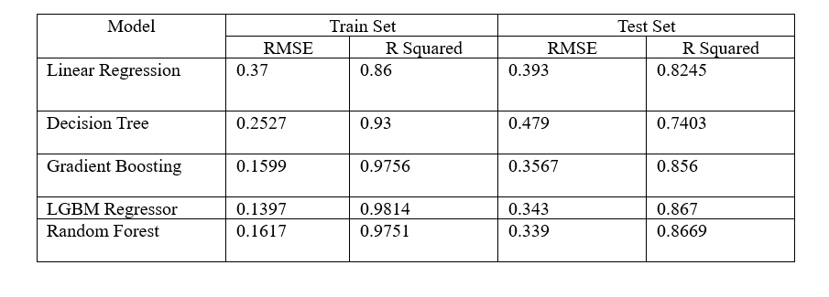
Predicting the Student Portuguese Score
To forecast students' math scores, we are utilizing several models, with the resulting graphs shown below.

Slide 8
Student Clustering (Unsupervised Learning)
Clustering Technique: K-Prototypes was used because standard algorithms cannot handle the dataset's mixed categorical and continuous variables.
Optimal Clusters: The Elbow Method identified 3 as the most mathematically efficient number of clusters for this dataset.
Model Success: Students were successfully grouped into three main categories, achieving a silhouette score of 0.35.
Group Interpretations: Based on mean scores, the clusters represent low-performing students, moderately performing students, and high-performing students.

Slide 9

Conclusion & Educational Impact
Combined Value: Utilizing both prediction and clustering gives a much deeper insight into student performance and behavior.
Critical Indicators: Previous academic results (especially G2) and attendance records have a significant impact on final performance.
Early Intervention: These findings can help educators identify struggling students early and provide targeted support.
System Improvement: Ultimately, this approach supports making better, data-driven decisions to enhance the educational environment.

Slide 10
Thank You

